Slide 1
Production of ova in females
has cyclic changes in the ovaries and in the uterus
important event in the ovaries:
ovulation (排卵)
important event in the uterus:
menstruation (月經)

Slide 2
Ovulation
usually only one follicle matures completely each month
takes place in one of the two ovaries approximately every 28 days

Slide 3
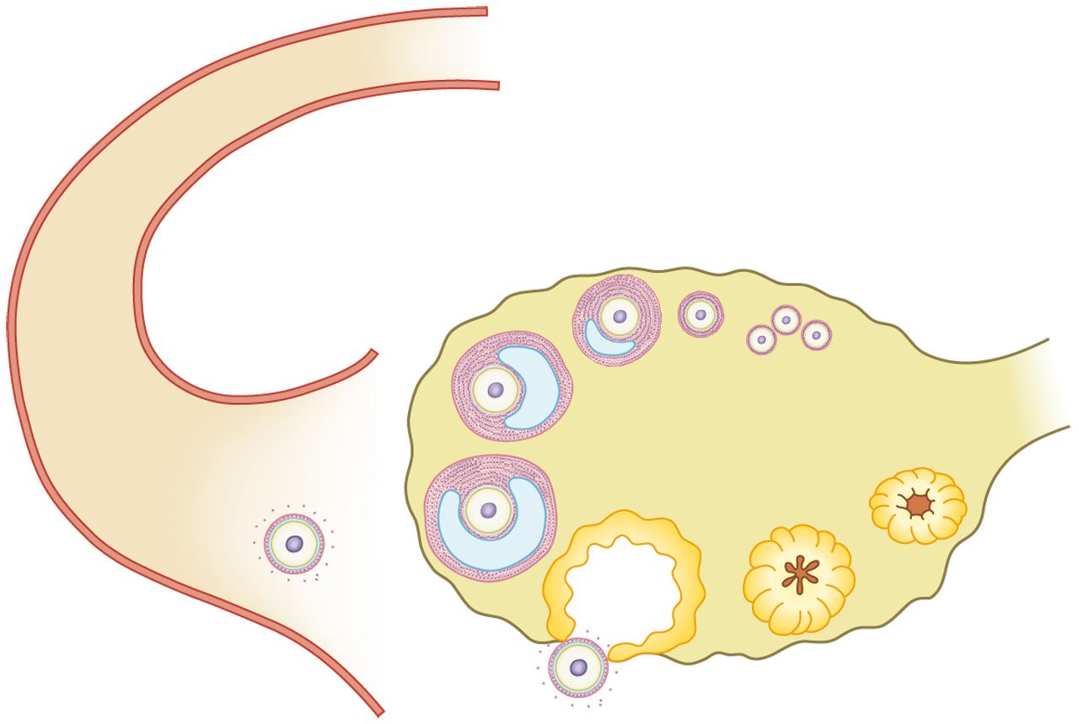
Ovulation
developing follicle
follicles with potential ova
grows bigger
oviduct
ovary

Slide 4
Ovulation
the follicle moves to the surface of the ovary
developing follicle
mature follicle
oviduct
ovary

Slide 5
Ovulation
ovulation: the mature follicle ruptures and releases an ovum into the funnel-shaped opening of the oviduct
mature follicle
oviduct
ovary
ruptured follicle

Slide 6


The beating action of cilia lining the oviduct creates a current to suck the ovum into the oviducts.
Ovulation
mature follicle
oviduct
ovary
ruptured follicle

Slide 7
After ovulation
the ruptured follicle becomes the yellow body (黃體)
yellow body degenerates
if no fertilization occurs
(corpus luteum)
yellow body degenerates
oviduct
ovary
yellow body
ruptured follicle

Slide 8
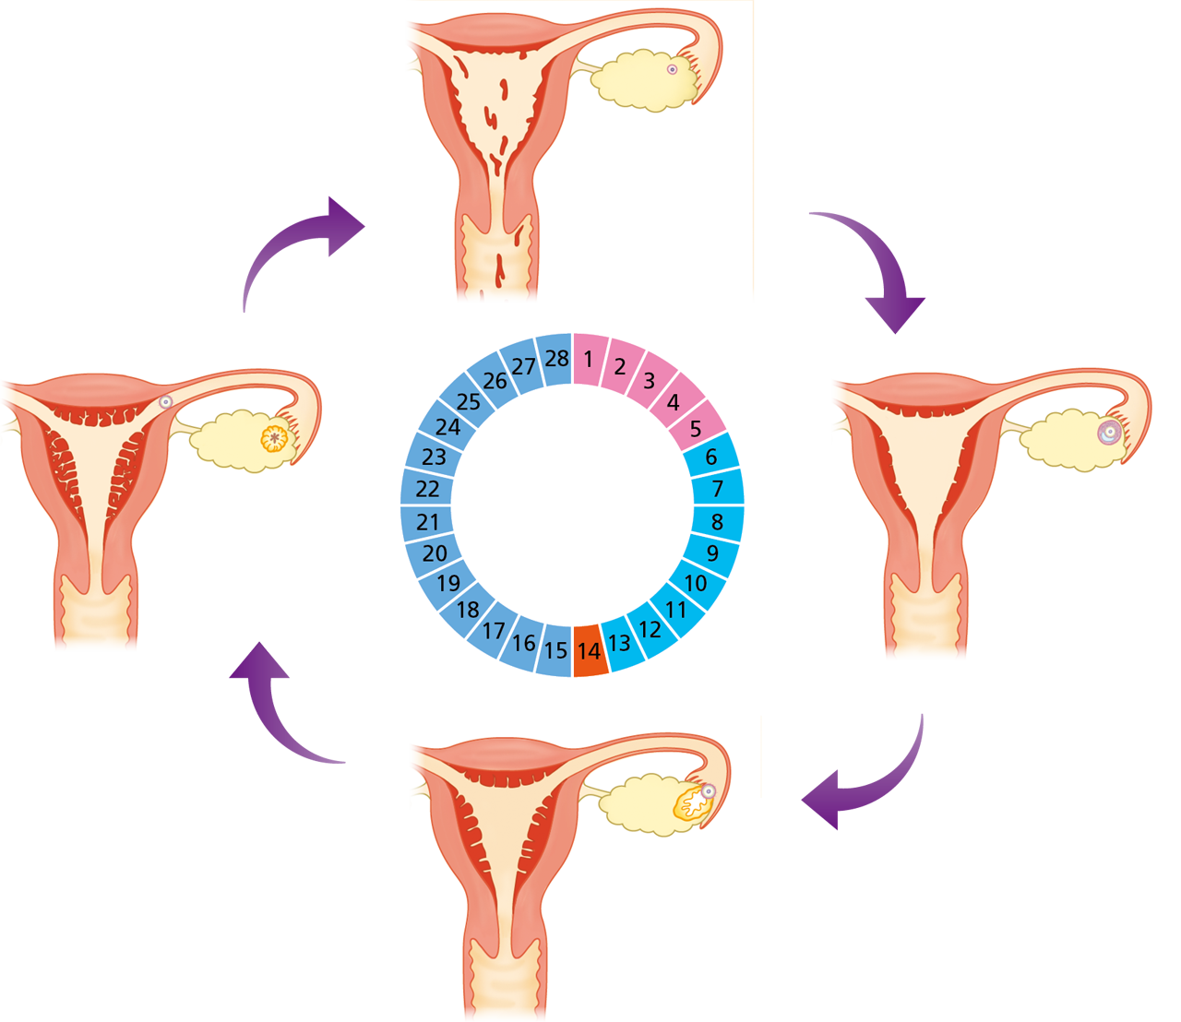
Menstrual cycle (月經週期)
the cycle of building up and breakdown of the uterine lining
lasts for about 28 days

Slide 9
What happens in the menstrual cycle?
fertilization does not occur…
the thickened uterine lining breaks down
Day 1 to 5: Menstruation

Slide 10
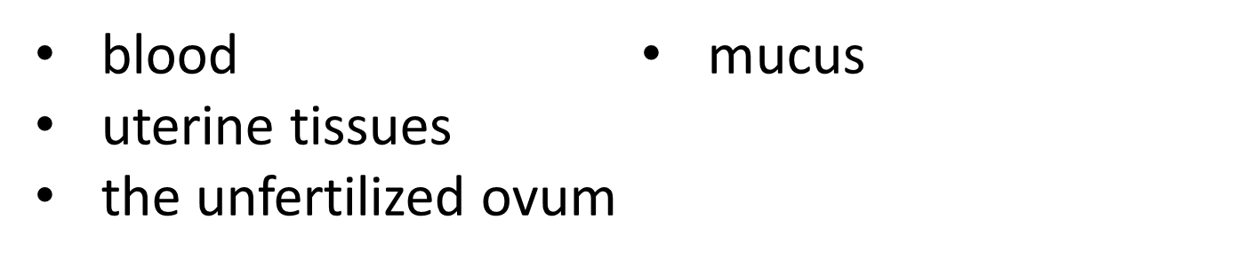
What happens in the menstrual cycle?
menstrual blood passes out of the body through the vagina
components of menstrual blood:
Day 1 to 5: Menstruation

Slide 11
What happens in the menstrual cycle?
a follicle in the ovary develops and secretes oestrogen (雌激素)
Day 6 to 13: Repairing of the uterine lining

Slide 12
What happens in the menstrual cycle?
oestrogen causes the uterine lining to repair and thicken
Day 6 to 13: Repairing of the uterine lining

Slide 13
What happens in the menstrual cycle?
uterine lining:
becomes thick and spongy for receiving an embryo
richly supplied with blood vessels to supply the embryo with oxygen and nutrients

Slide 14
What happens in the menstrual cycle?
the mature follicle ruptures and releases an ovum into the oviduct
Day 14: Ovulation

Slide 15
What happens in the menstrual cycle?
after ovulation, the uterine lining further thickens and is ready to receive an embryo
Day 15 to 28: Further thickening of the uterine lining
a new cycle begins if fertilization does not occur

Slide 16
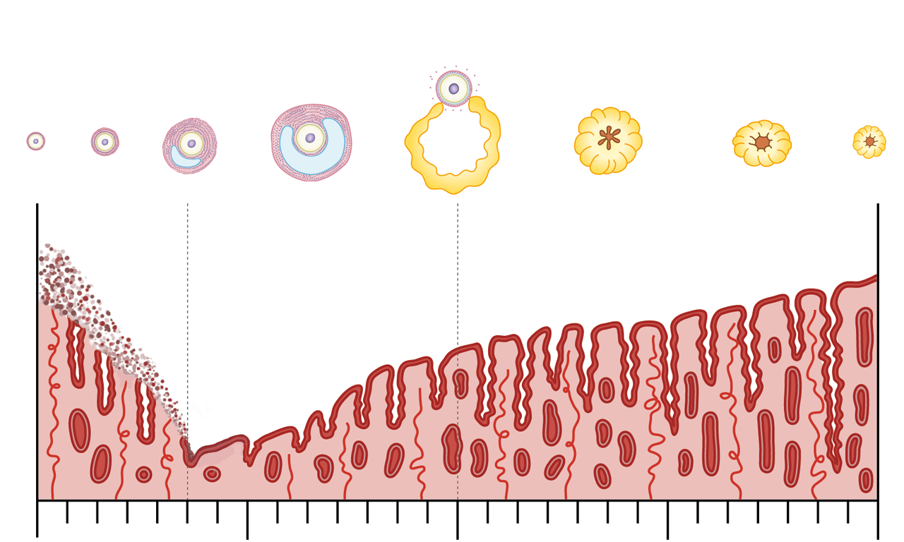
The events occurring in the ovary and the thickness of the uterine lining
developing follicles
Events in the ovary
Thickness of uterine lining
Day
0 5 14 28
menstruation

Slide 17
The events occurring in the ovary and the thickness of the uterine lining
mature follicle
Events in the ovary
Thickness of uterine lining
Day
0 5 14 28
uterine lining building up

Slide 18
The events occurring in the ovary and the thickness of the uterine lining
ovulation
Events in the ovary
Thickness of uterine lining
Day
0 5 14 28
ovulation

Slide 19
The events occurring in the ovary and the thickness of the uterine lining
yellow body
degenerating yellow body
Events in the ovary
Thickness of uterine lining
Day
0 5 14 28
uterine lining becomes very thick

Slide 20
The events occurring in the ovary and the thickness of the uterine lining
if fertilization occurs and the woman becomes pregnant:
the uterine lining does not break down
(no menstruation)
menstruation will occur after the birth of the baby

Slide 21

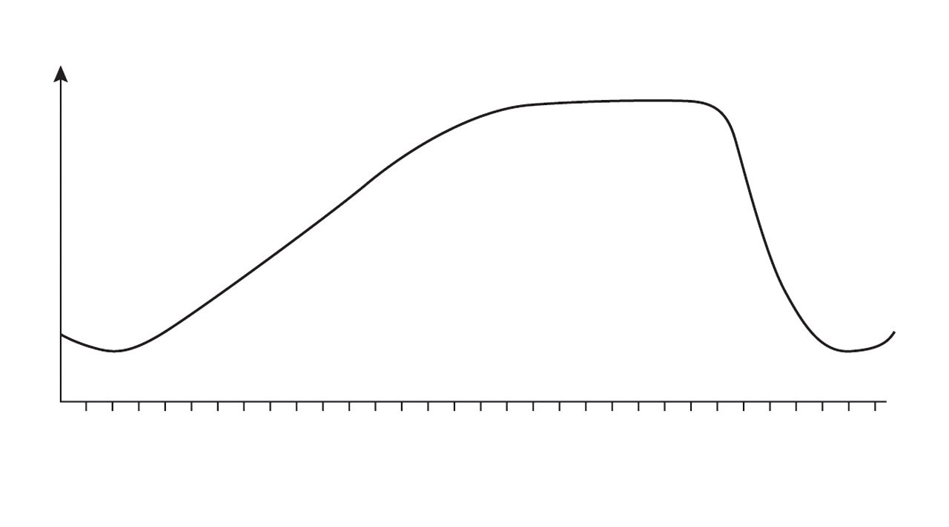
Directions: Questions 1 and 2 refer to the graph below, which shows the changes in the thickness of the uterine lining of a woman in a certain month.
Thickness of uterine lining
1
3
5
7
9
11
13
15
17
19
21
23
25
27
29
31
Day of the month

Slide 22
Menstruation is likely to have occurred during
the 1st to 5th day.
the 9th to 13th day.
the 19th to 23th day.
the 26th to 30th day.
D

Slide 23
Ovulation is most likely to have occurred on around
the 3rd day.
the 12th day.
the 19th day.
the 26th day.
B

